Slide 1
E-Learning Portal
by –
Siddhi Kulkarni
(batch-2b)

Slide 2
Technologies used
Backend – Spring, Java
Database – MySQL
Frontend – JSP
Server – Apache Tomcat

Slide 3
functionalities
User
User registration
User login/logout
Course Enrollment
Contact Admin
Send Feedback
View/Update/Delete Profile
Admin
Admin login/logout
View users
Add new course
Update/Delete Course
View enrolled courses
View Contacts
View Feedbacks
New admin registration

Slide 4
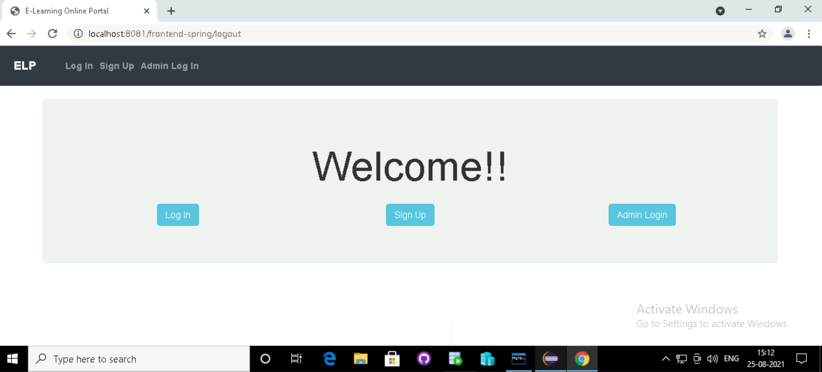
LANDING pAGE

Slide 5
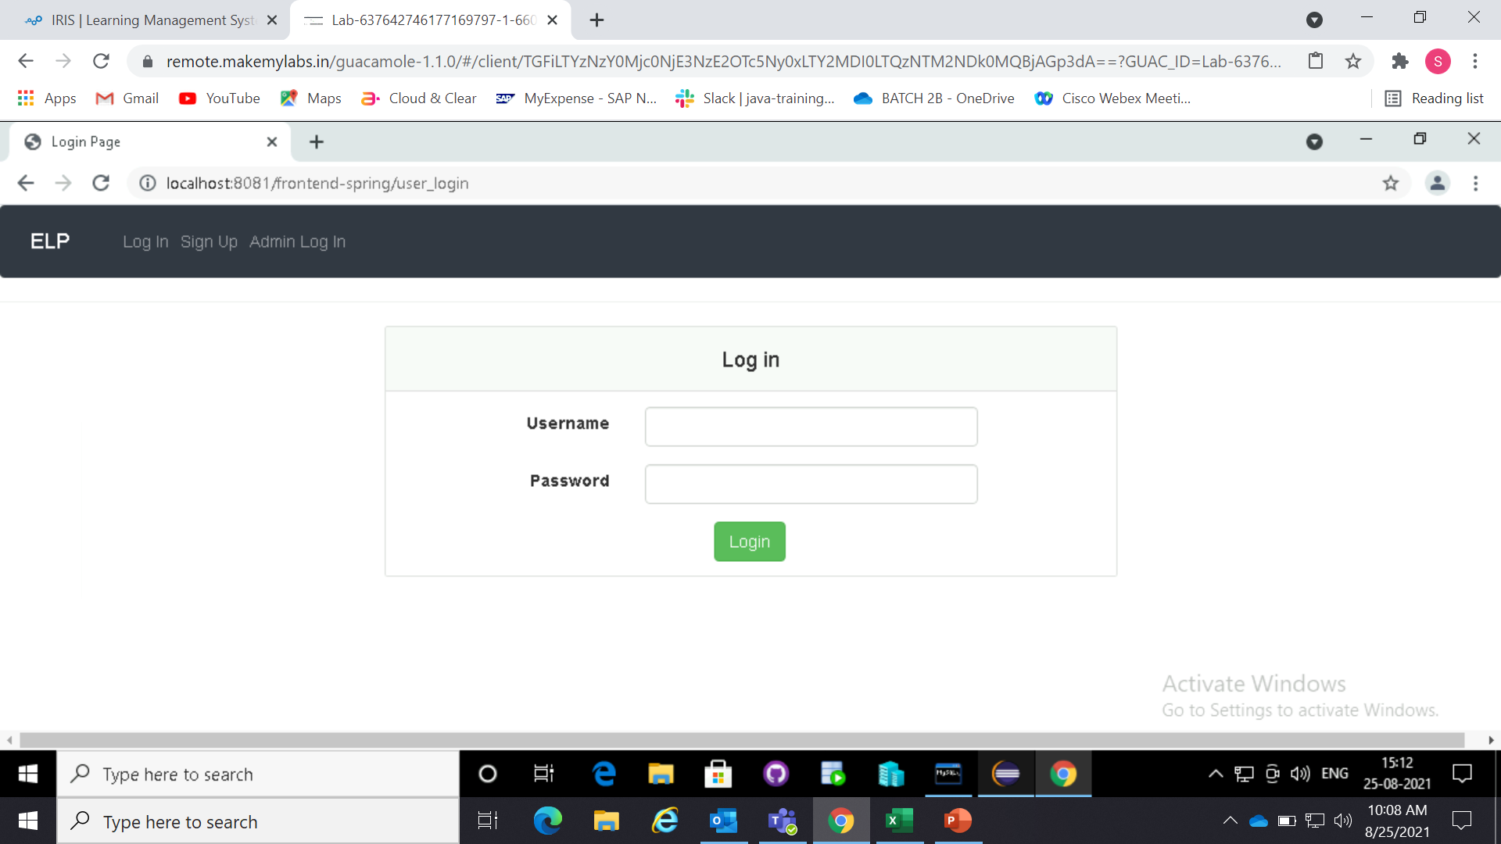

LOGIN

Slide 6
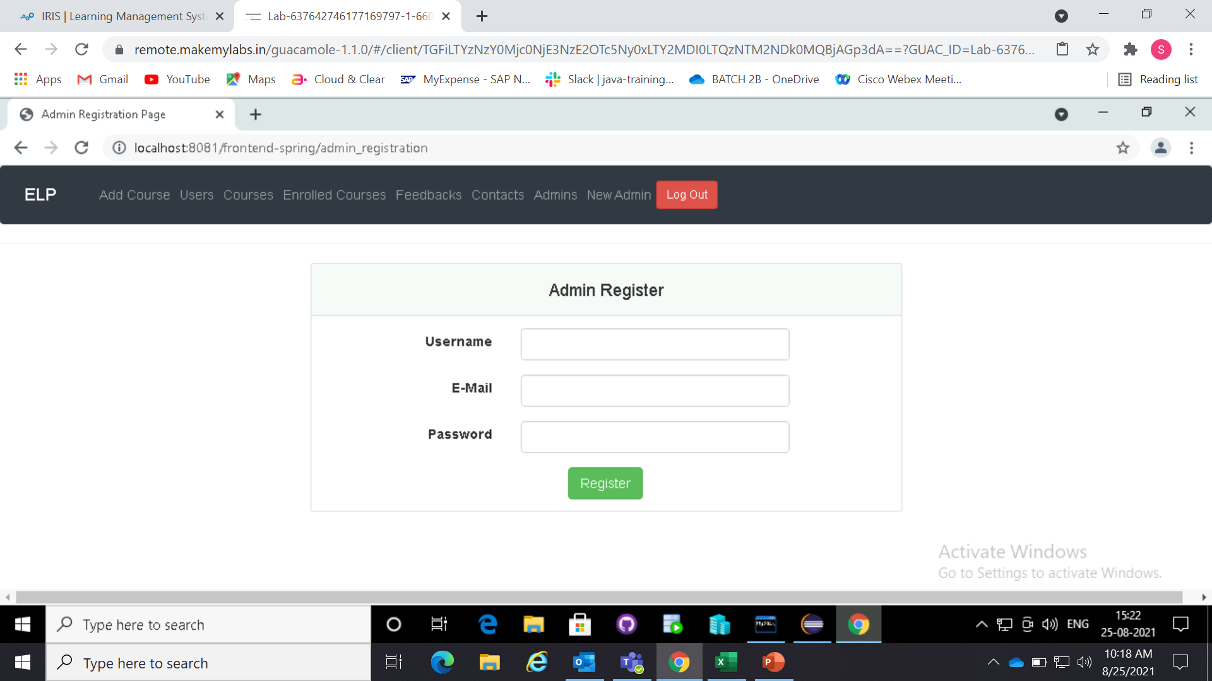
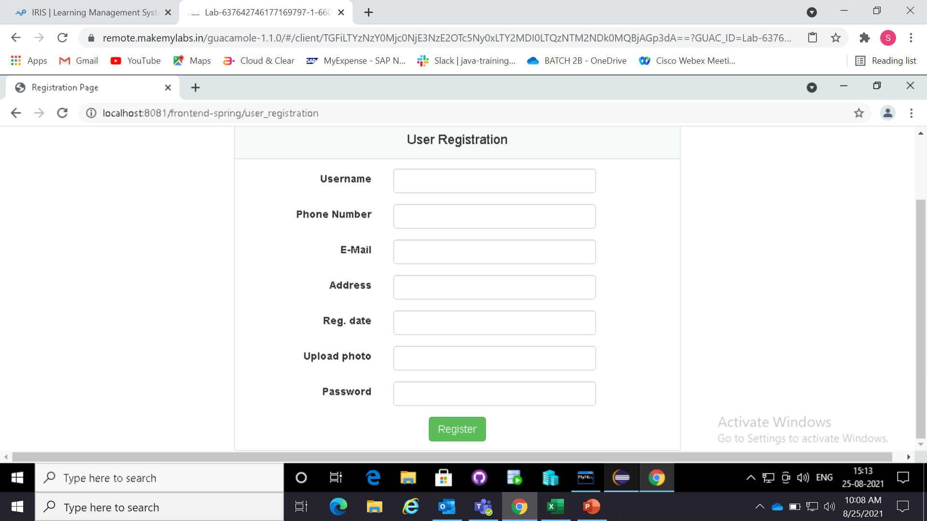
registration

Slide 7
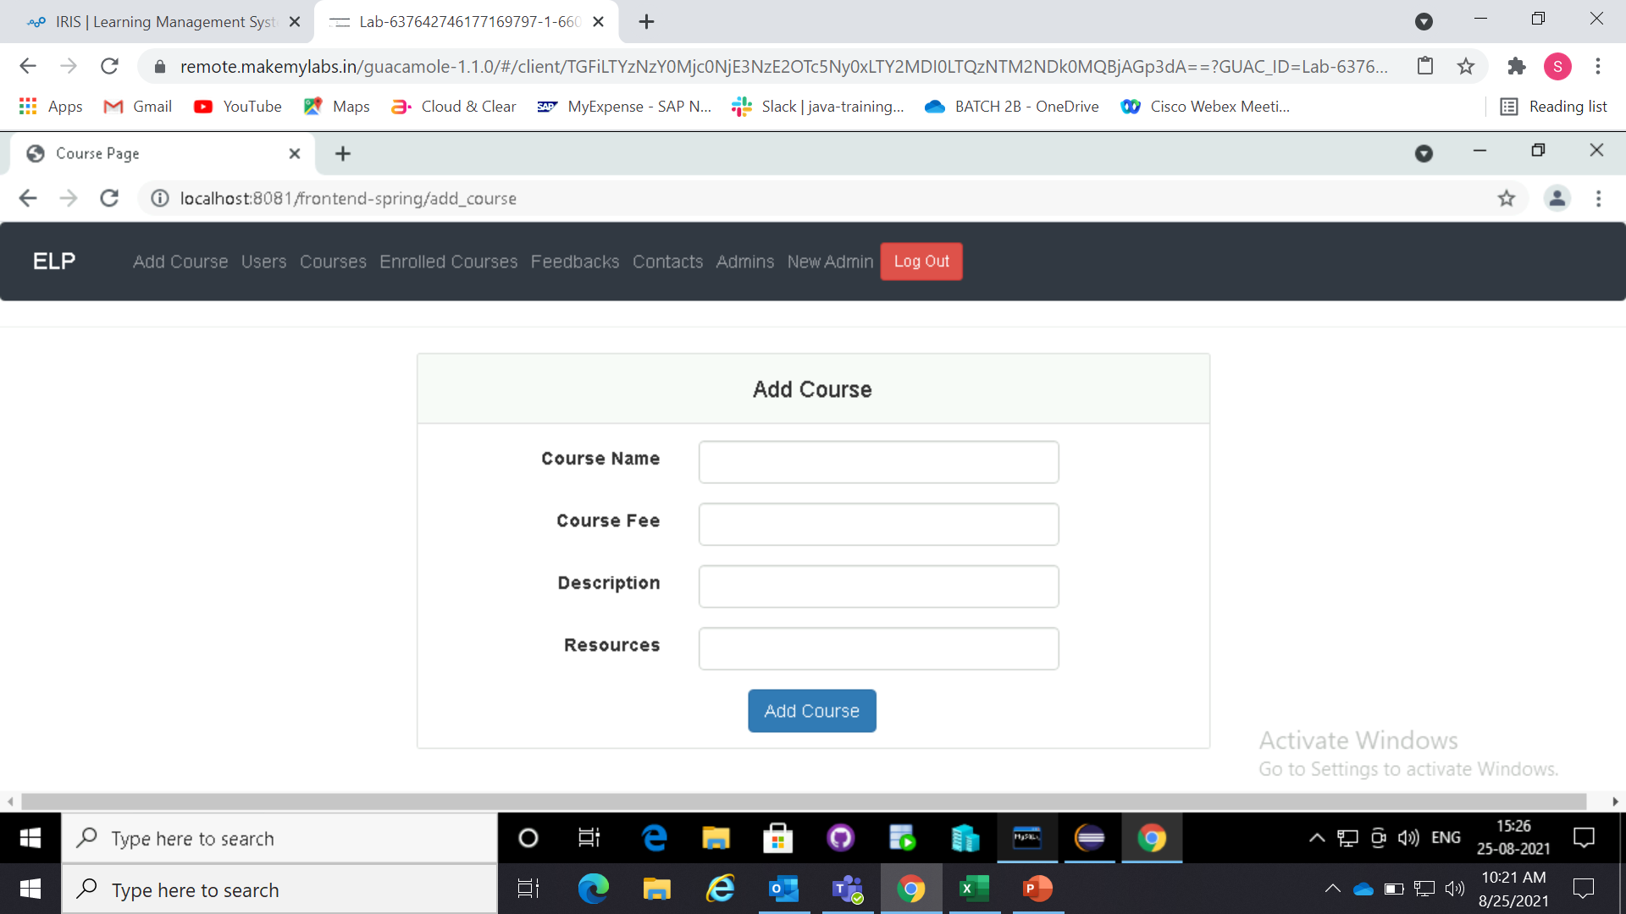
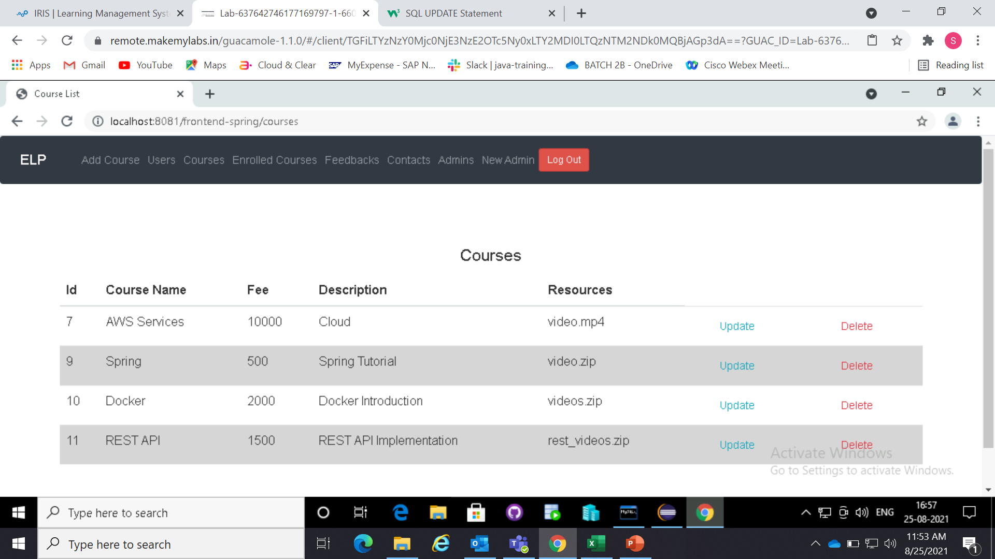
Add course
All courses

Slide 8
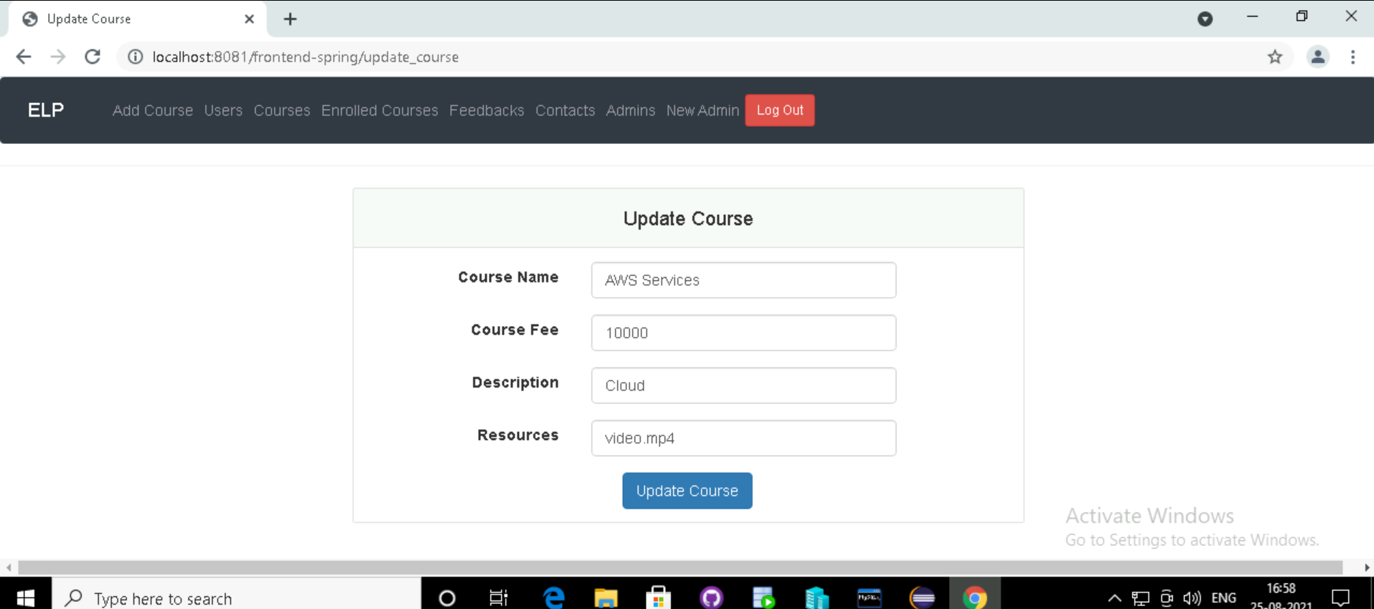
Update course

Slide 9
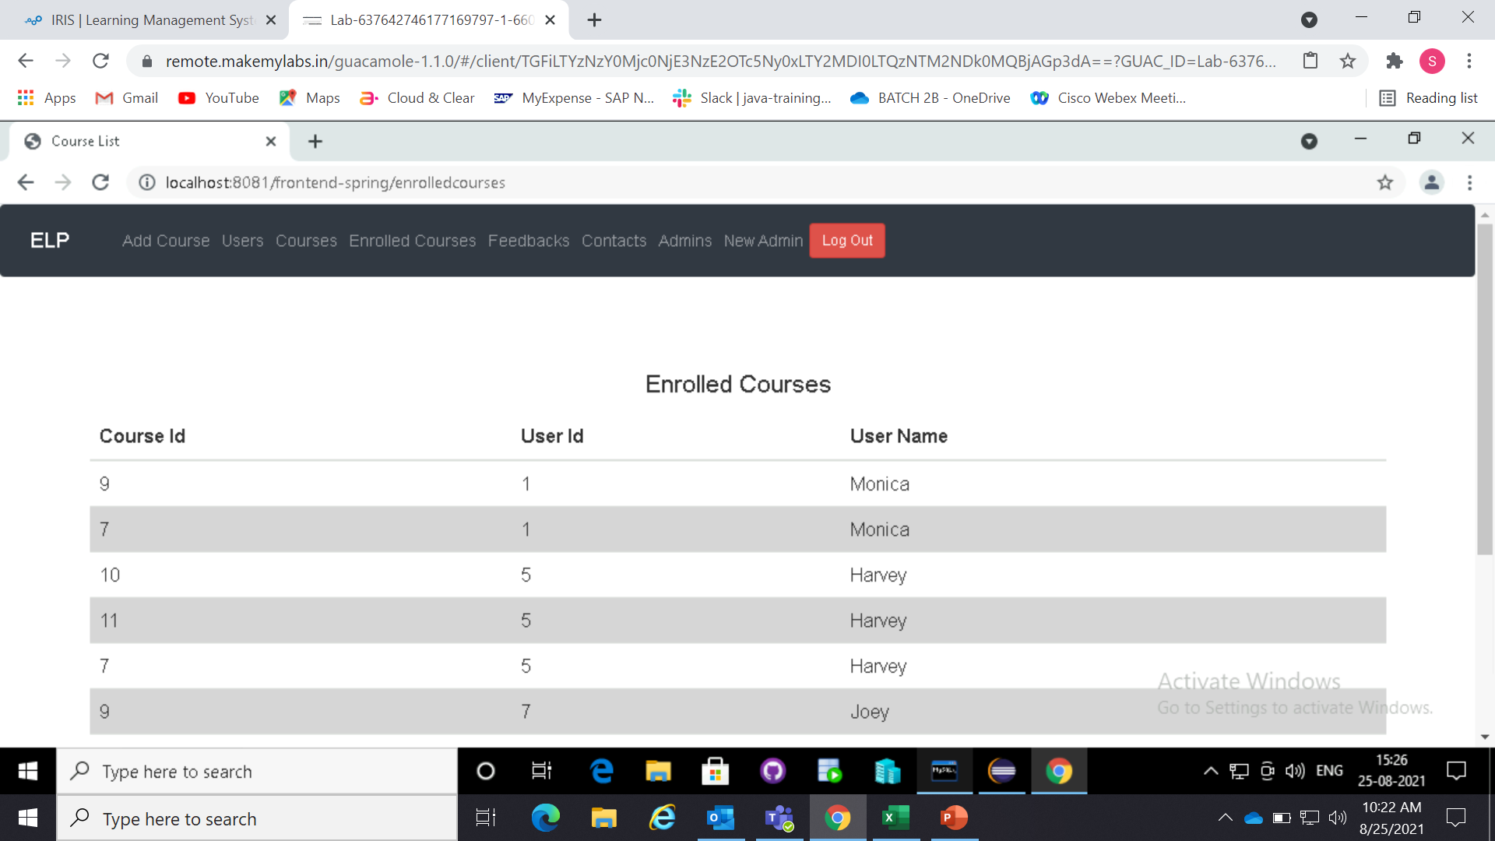
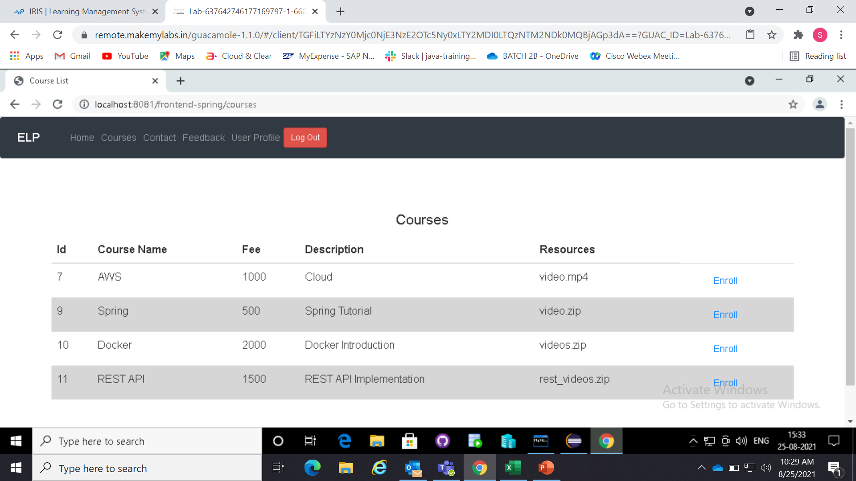
Enrolled courses
(admin)
Course enrolling
(user)

Slide 10
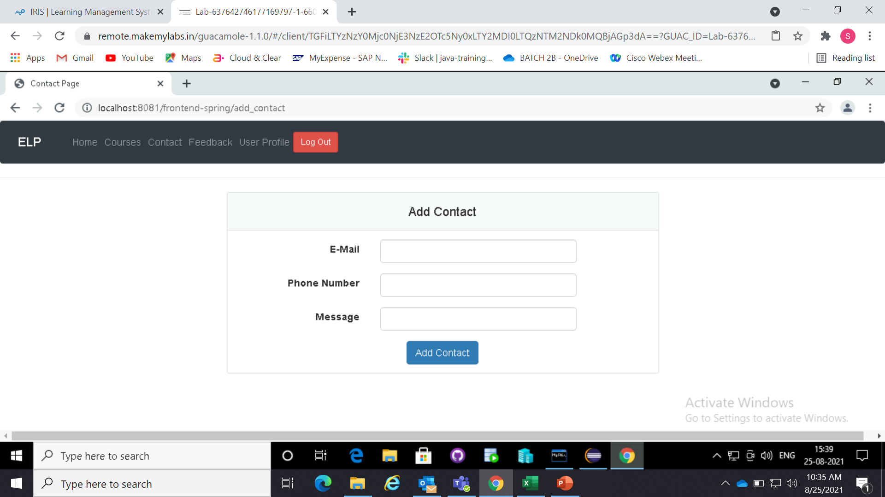
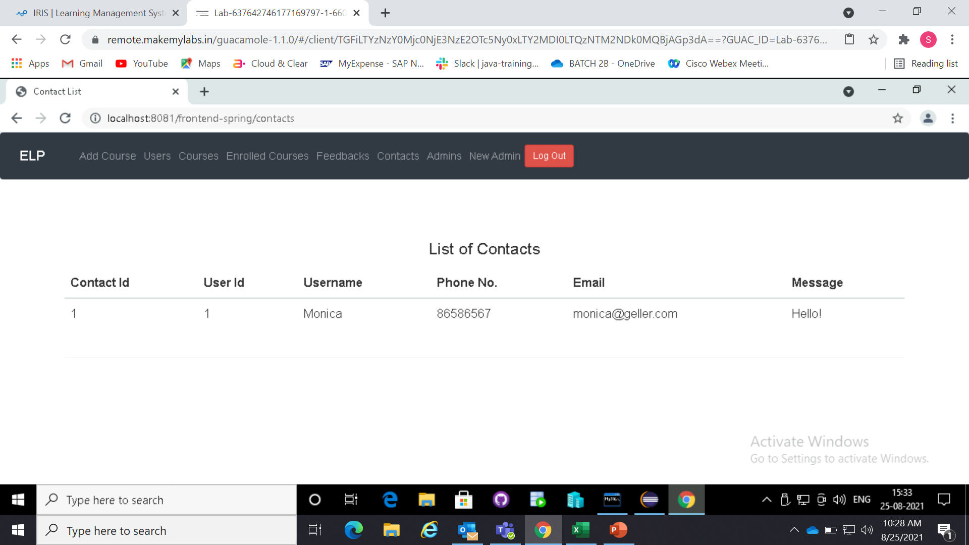
Add contact
(user)
All contacts
(admin)

Slide 11


Add feedback
(user)
All feedbacks
(admin)

Slide 12
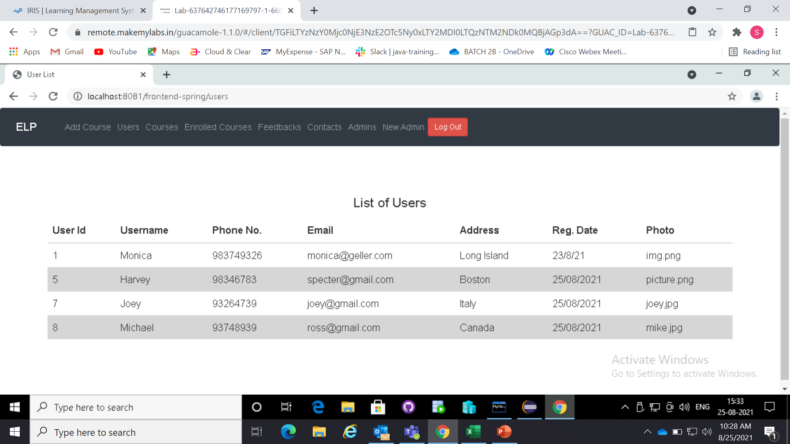
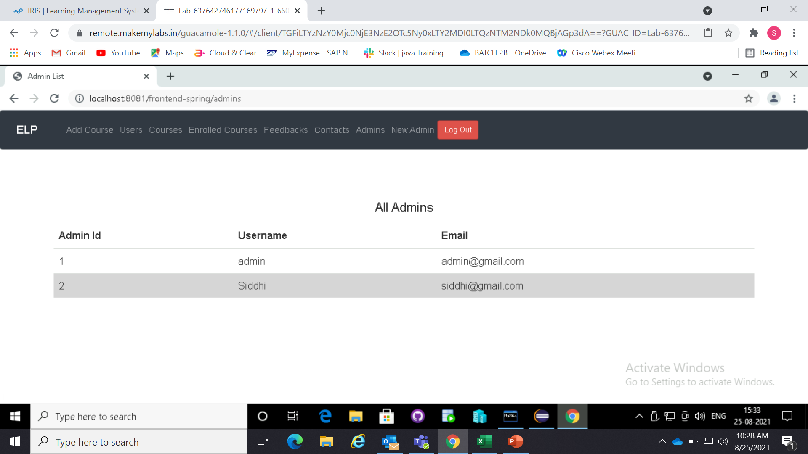
All users
(admin)
All admins
(admin)

Slide 13
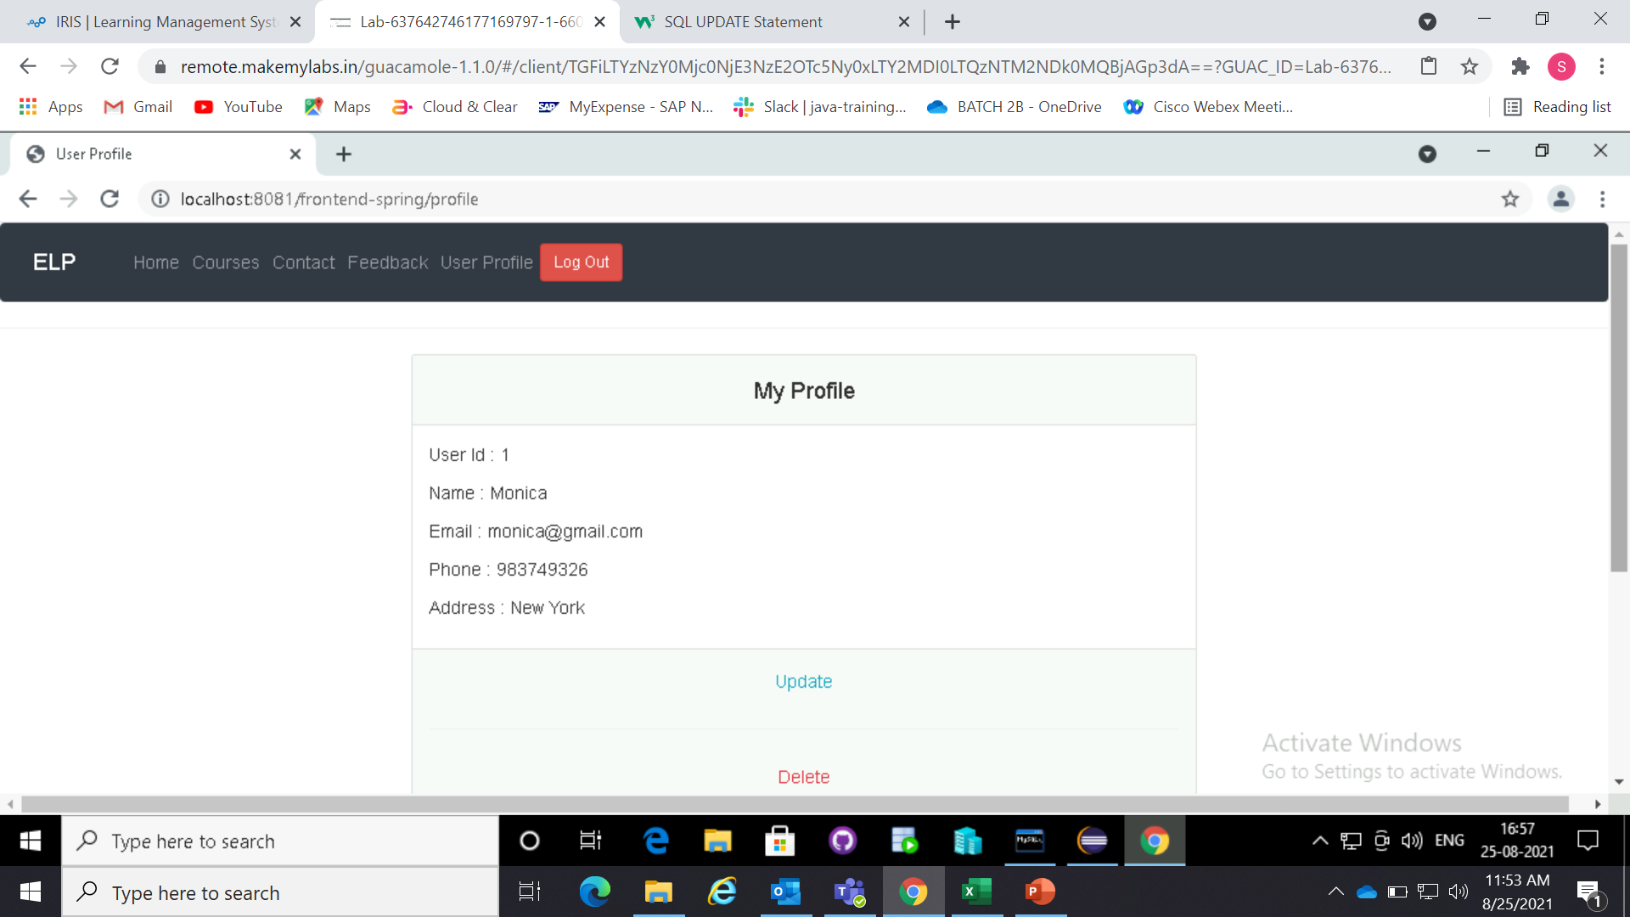
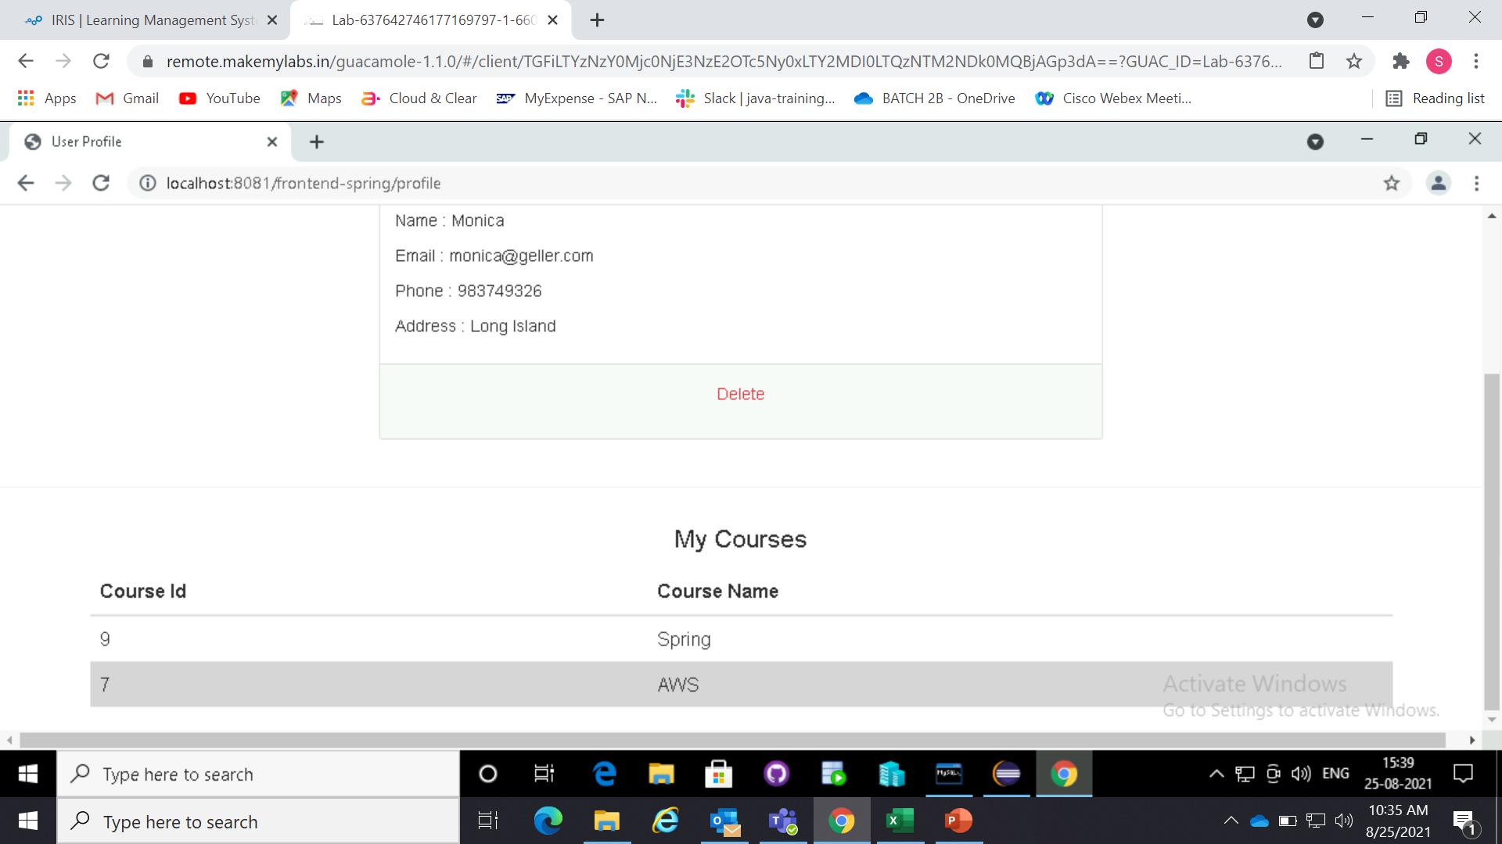
User profile

Slide 14
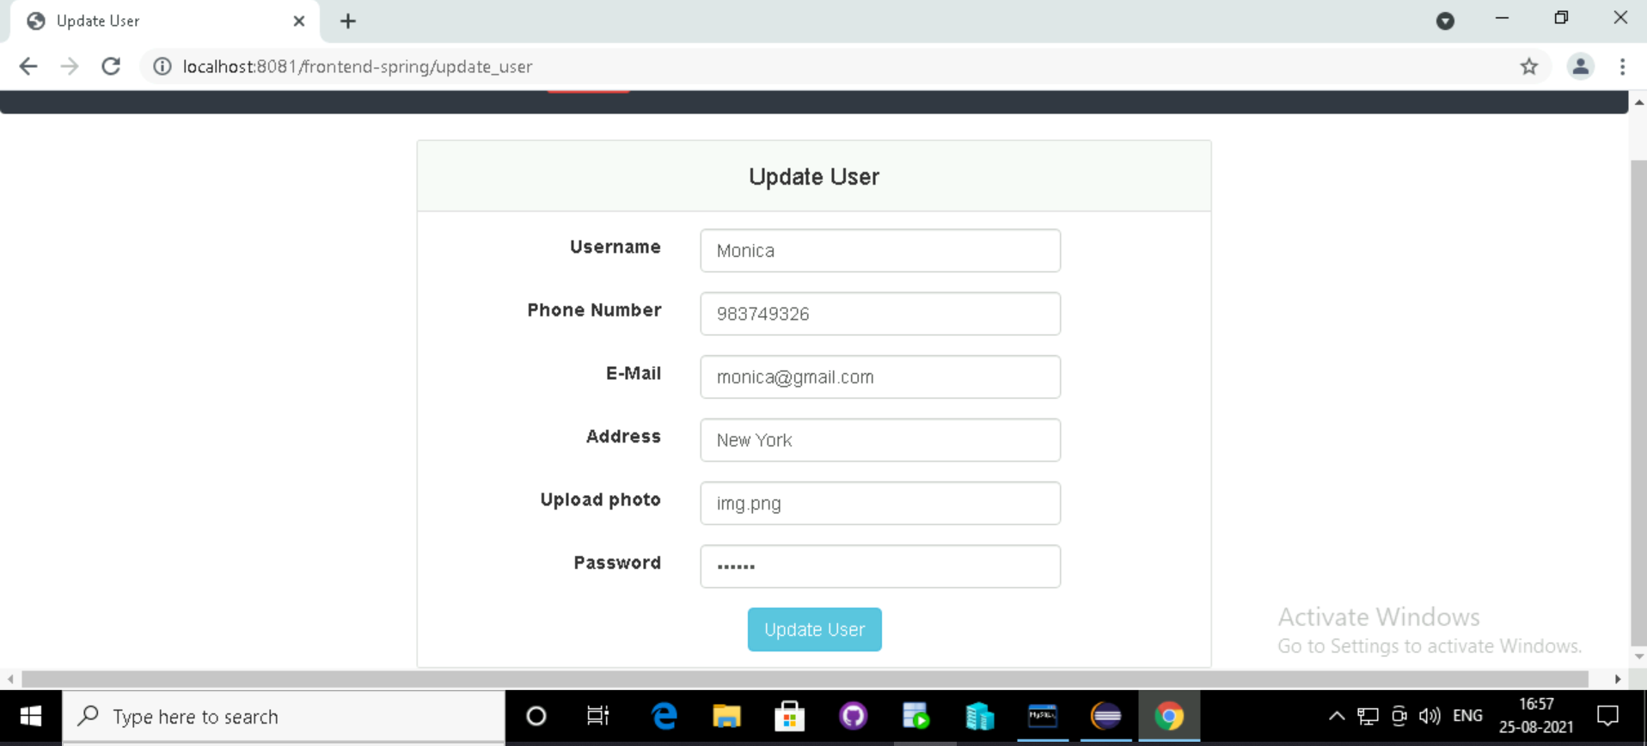
Update user

Slide 15
Thank you

